Slide 1
Serverless architecture:
Functions as a Service

Slide 2


Slide 3

Serverless is coming!

Slide 4
Serverless “hype”
News
Blog posts
Meetups
Conferences
…..

Slide 5


Slide 6
Chapter I: The hardest problem

Slide 7
The hardest problem in computer science
…is, of course, naming.

Slide 8
Serverless architecture!
Just right for front-end devs?

Slide 9
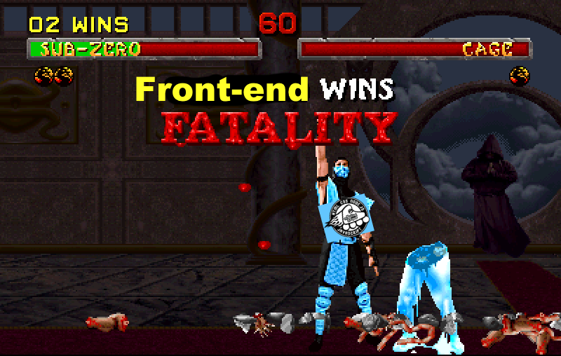
Angular.js developer
???
DevOps ?
Java dev?

Slide 10
NO
NO
NO

Slide 11
Fashionable Naming
Cloud Computing
Infrastructure as a service (IaaS)
Platform as a service (PaaS)
Function as a service (FaaS)
Serverless architecture
AWS Lambda, Phoenix Environments, API Gateway, ……..

Slide 12

Chapter II: From the Iron Age to the Cloud Age

Slide 13
Self-hosting (aka On-premise)

Slide 14
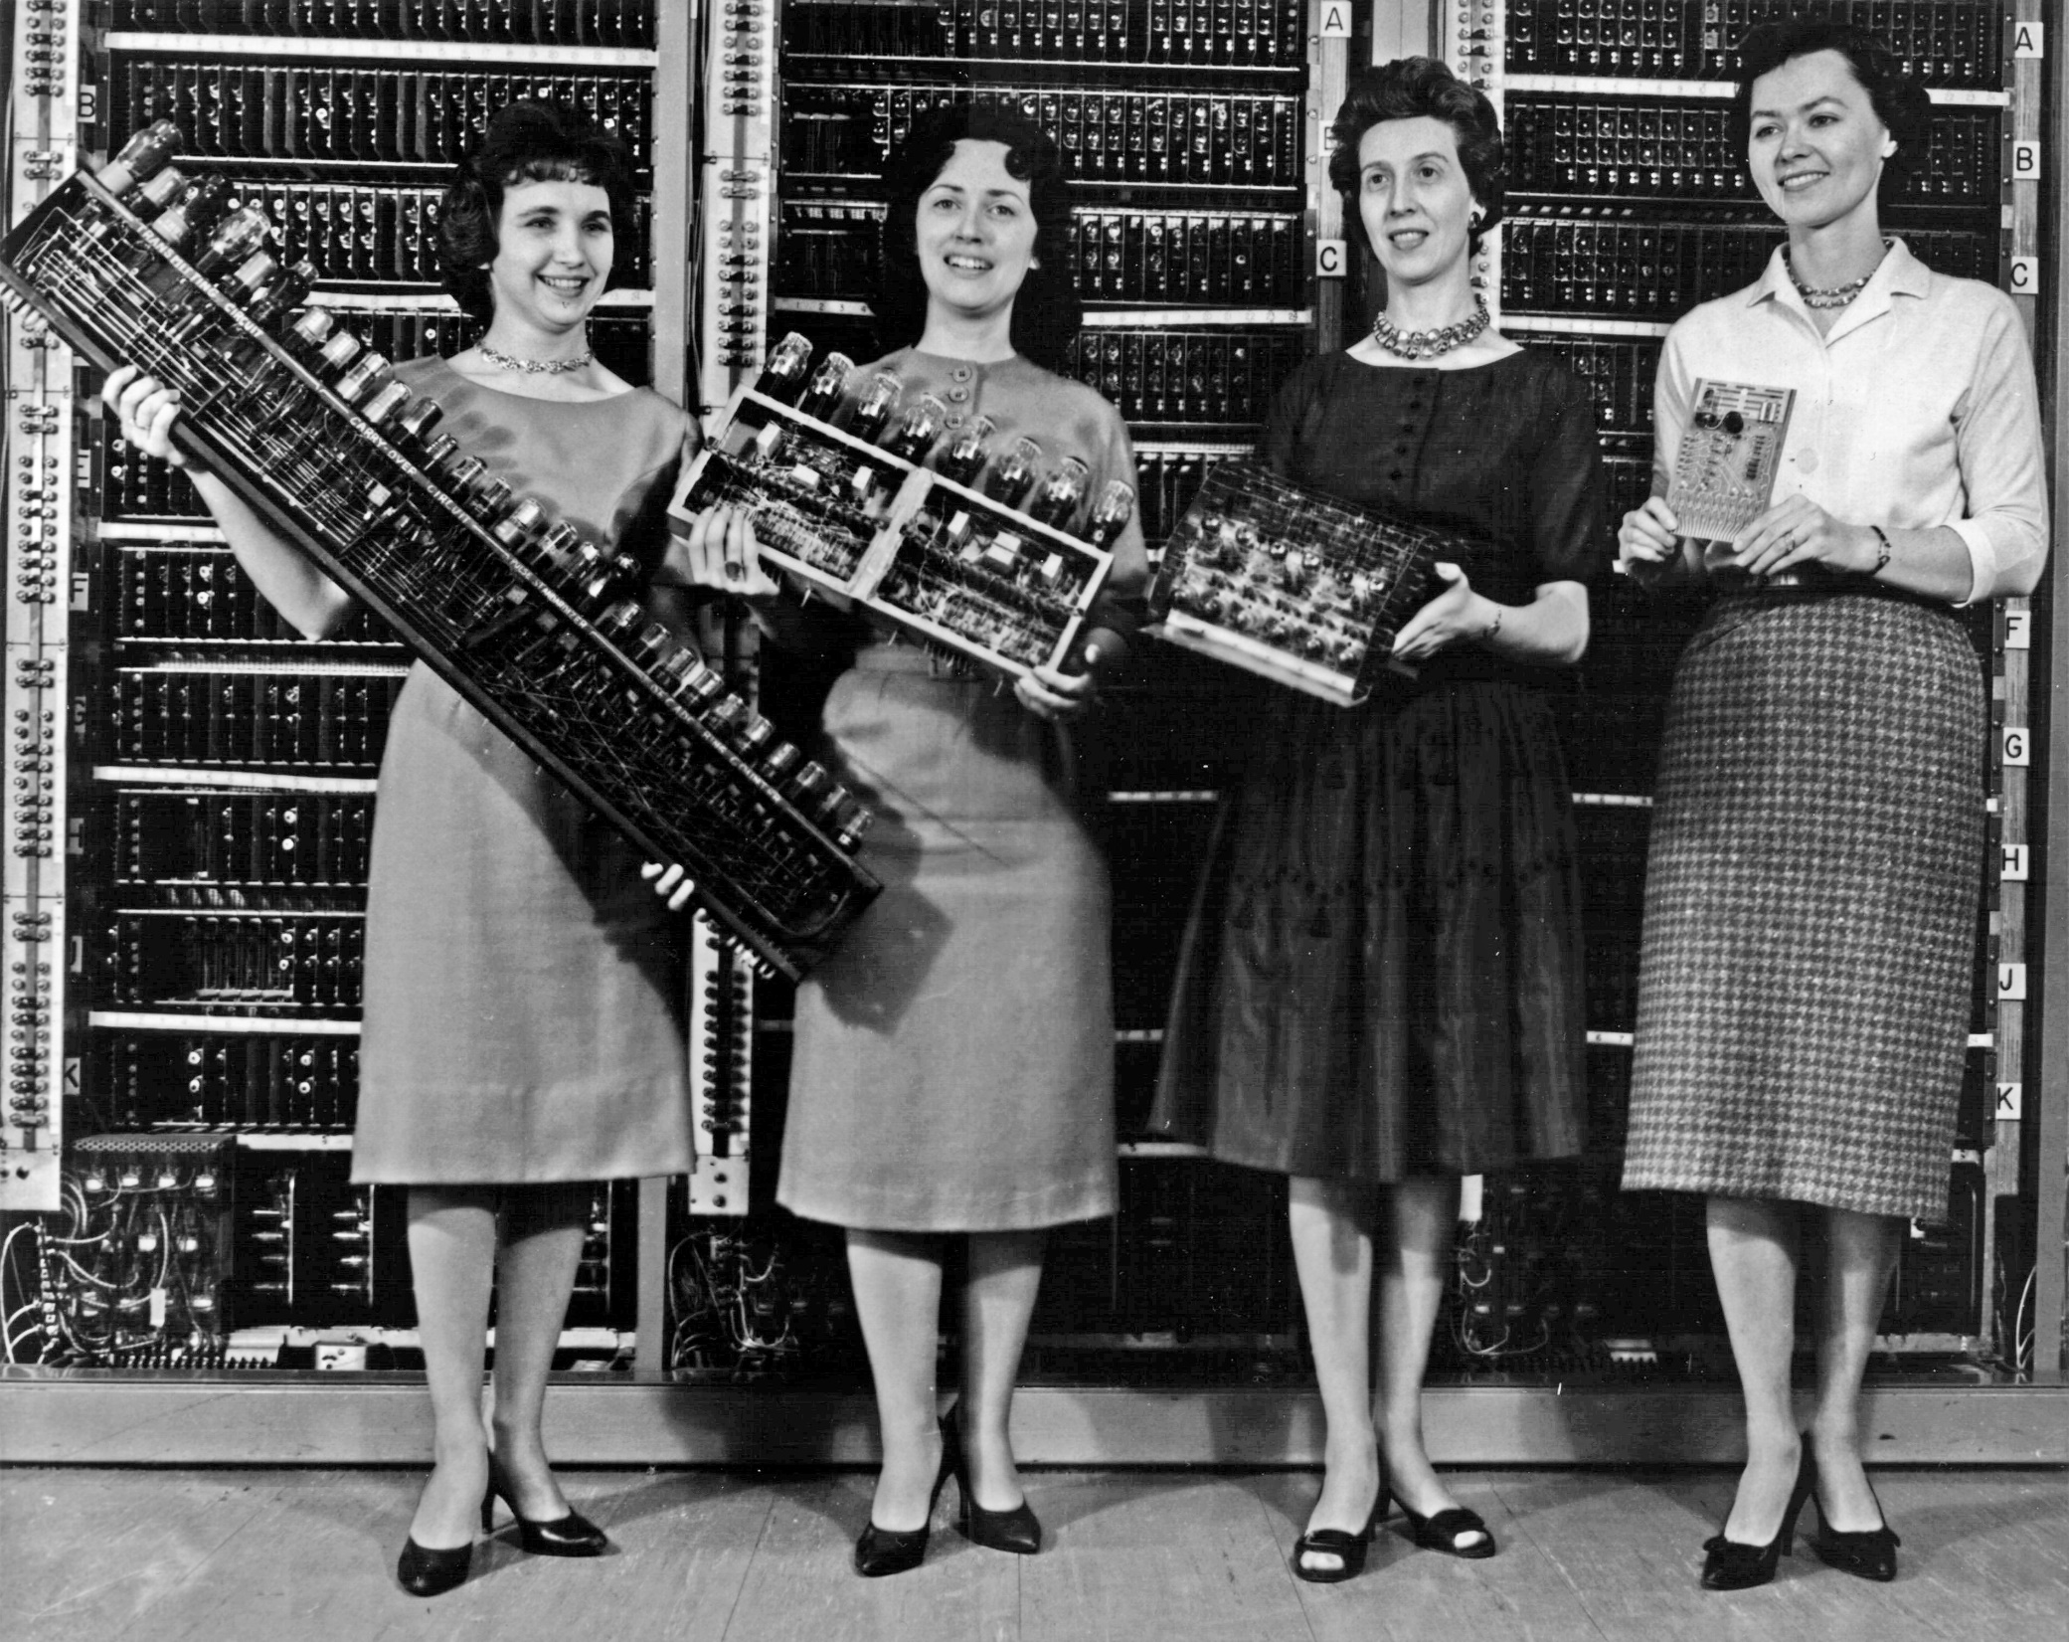
You buy and install hardware

Slide 15
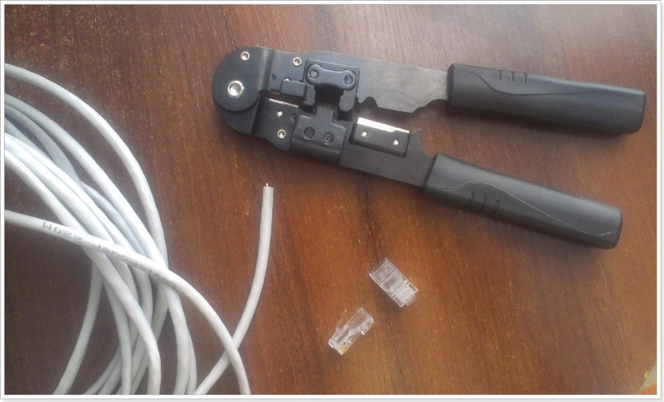
You manage networks

Slide 16
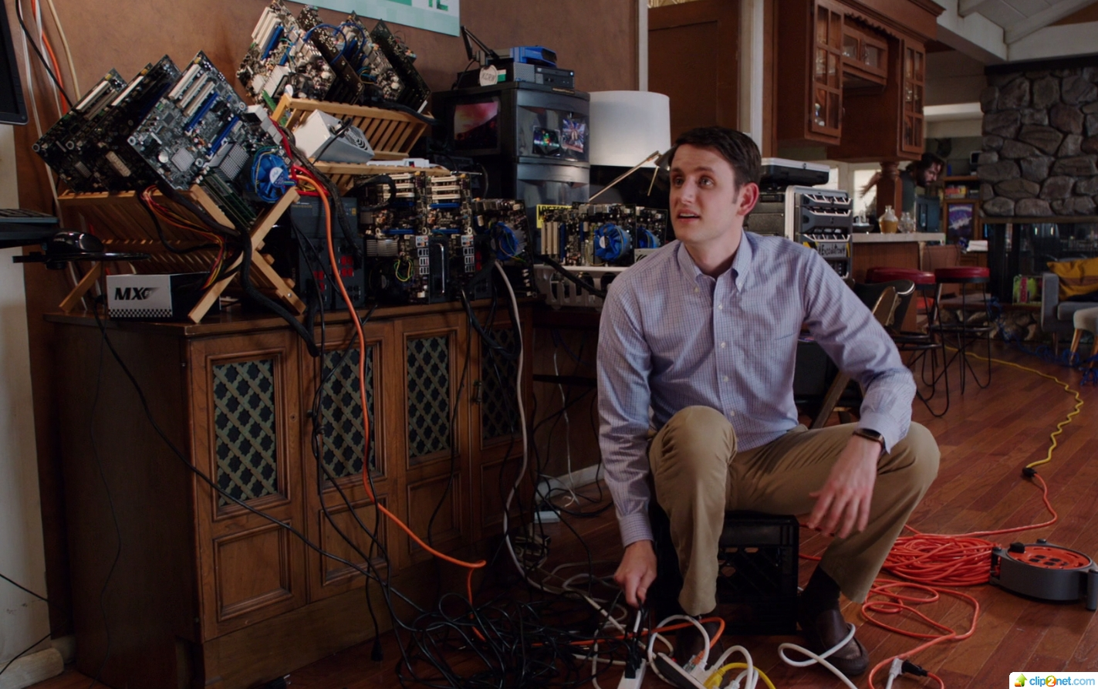
You scale
[Silicon Valley](http://www.imdb.com/title/tt2575988/)

Slide 17

You maintain

Slide 18
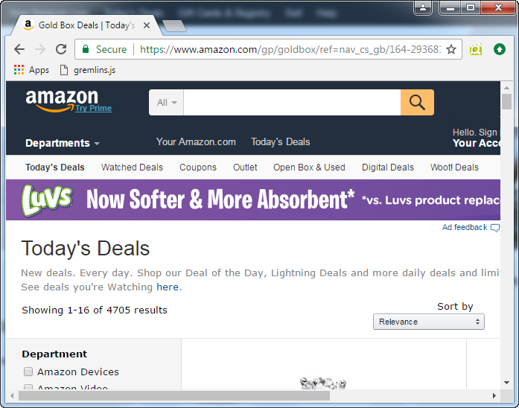
In Amazon we trust

Slide 19
Survey
“How Developers use Node.js”
1126 Respondents
https://blog.risingstack.com/node-js-developer-survey-results-2016/

Slide 20
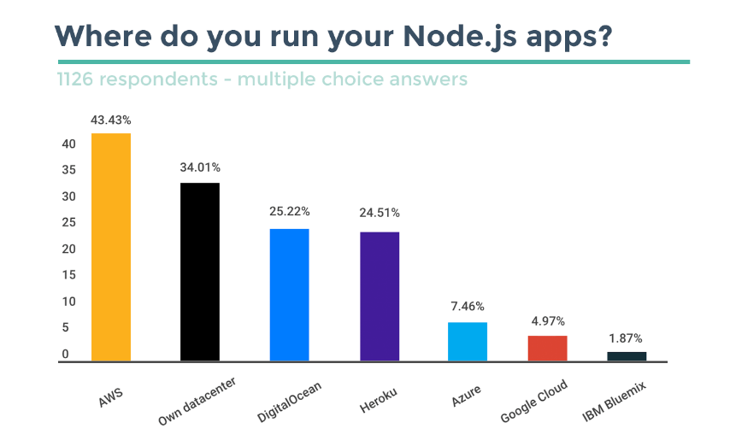
https://blog.risingstack.com/node-js-developer-survey-results-2016/

Slide 21
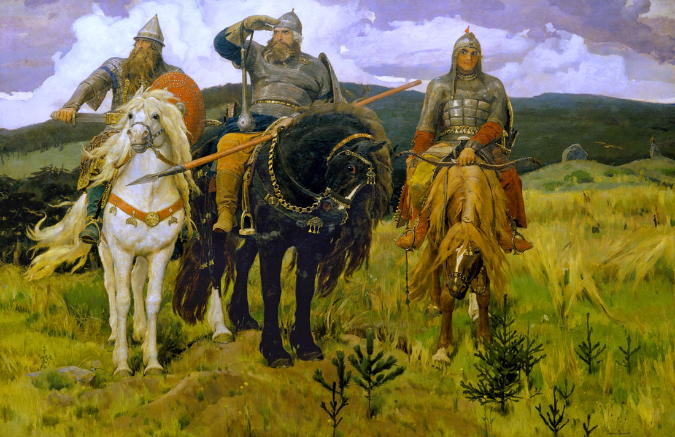
Three DevOps Survey

Slide 22

Results: 80-90% AWS/Hubrid/ Private cloud
Google
Azure
AWS
IBM

Slide 23
Private cloud

Slide 24
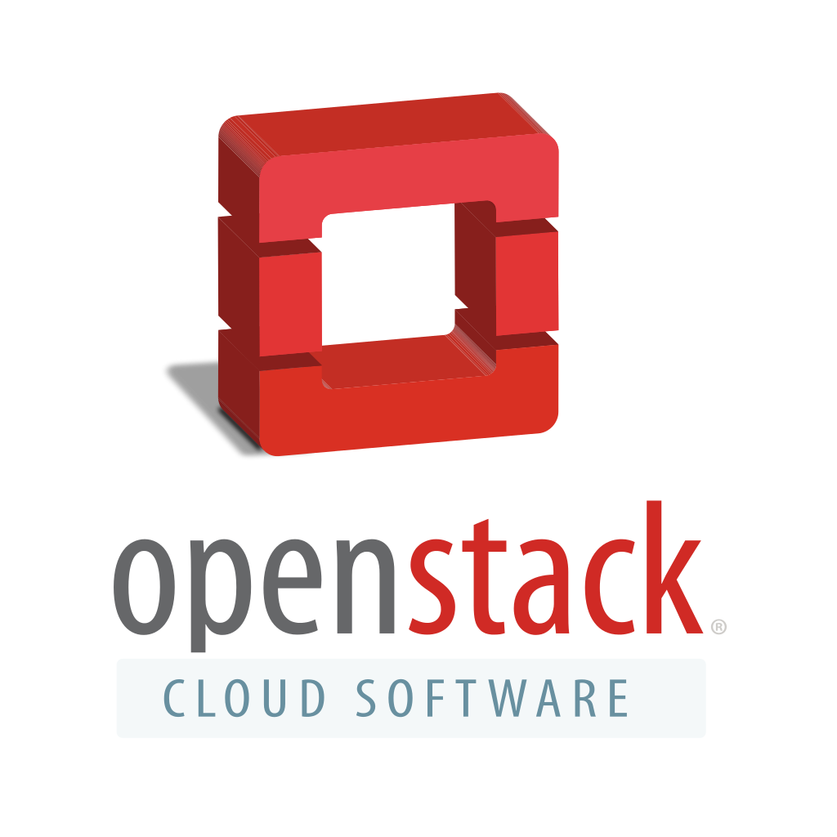
PayPal OpenStack Private Cloud
Physical servers: 8000+
Total cores: 400 000+
Number of VMs: 82000+
Storage: 2 petabytes
Processed $228 billion in payments last year
https://www.openstack.org/summit/tokyo-2015/videos/presentation/architectures-for-successful-openstack-cloud-deployment

Slide 25
Hybrid cloud

Slide 26
Chapter III: Cloud computing services

Slide 27
Infrastructure as a service (IaaS)
is a form of cloud computing that provides
virtualized computing resources
over the Internet.

Slide 28
VS
Self Hosting
Infrastructure as a service
YOU MANAGE
Applications
Data
Runtime
Middeware
O/S
Virtualization
Servers
Storage
Networking
YOU MANAGE
Applications
Data
Runtime
Middeware
O/S
VENDOR
Virtualization
Servers
Storage
Networking

Slide 29

VS
Self Hosting
Infrastructure as a service
YOU MANAGE
Applications
Data
Runtime
Middeware
O/S
Virtualization
Servers
Storage
Networking
YOU MANAGE
Applications
Data
Runtime
Middeware
O/S
VENDOR
Virtualization
Servers
Storage
Networking

Slide 30
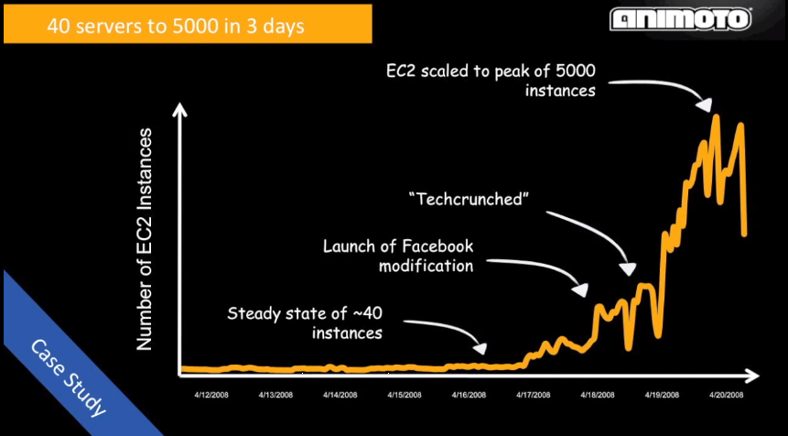
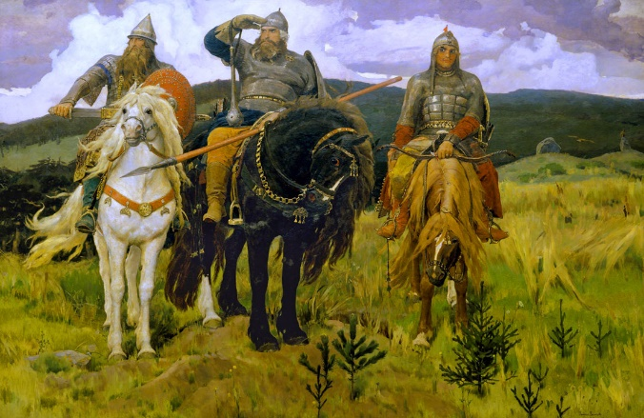

Slide 31
IAAS benefits
Infrastructure in minutes
Reduced operational cost
Pay as you go
Worldwide
Scalability and flexibility
Anytime, Anywhere, Access
“add dev/prod env, env in japan, add 1000 servers or remove 1000 servers - by clicking a button”

Slide 32
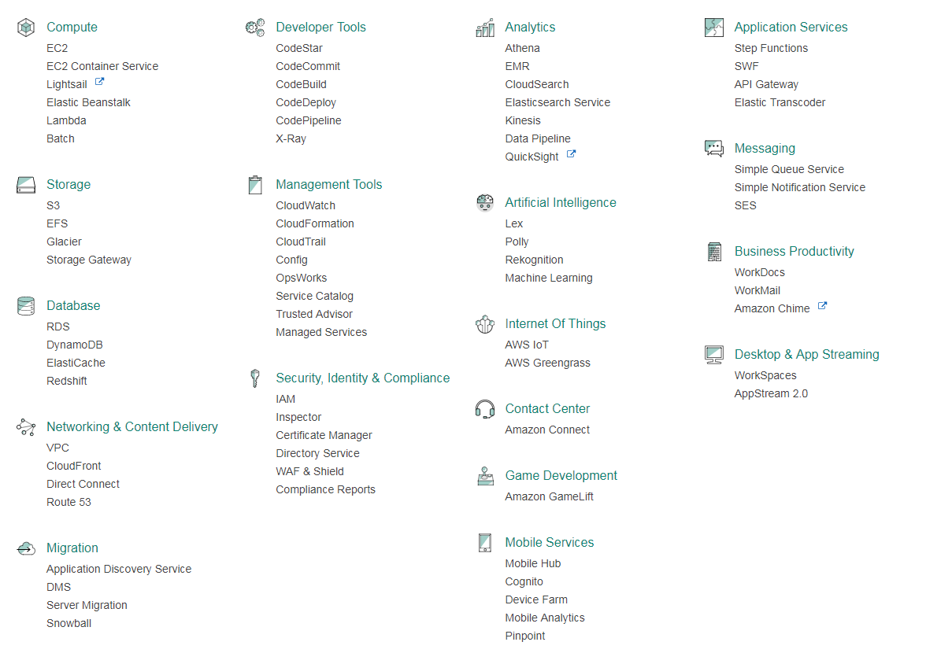

Slide 33
AWS Spot Market
“At the time of writing this (October 2016), an On-Demand r3.2xlarge instance (with 8 vCPUs and 61 GB RAM) costs $0.665 per hour in the US East region. However, the current Spot price for that instance is only $0.10… a cost savings of over 80%!”
https://databricks.com/blog/2016/10/25/running-apache-spark-clusters-with-spot-instances-in-databricks.html

Slide 34
AWS Spot Market
“Foursquare has started using the service, performing analytics across more than three million daily checkins and has reduced analytics costs by more than 50%. They have decreased processing time for urgent data-analysis, all without requiring additional application development or adding risk to the company’s analytics.”
https://siliconangle.com/blog/2011/08/18/amazon-web-services-offers-spot-market-capabilities-for-managing-hadoop-clusters/

Slide 35
Platform as a service

Slide 36
Platform as a service
YOU
Applications
Data
VENDOR MANAGE
Runtime
Middeware
O/S
Virtualization
Servers
Storage
Networking

Slide 37
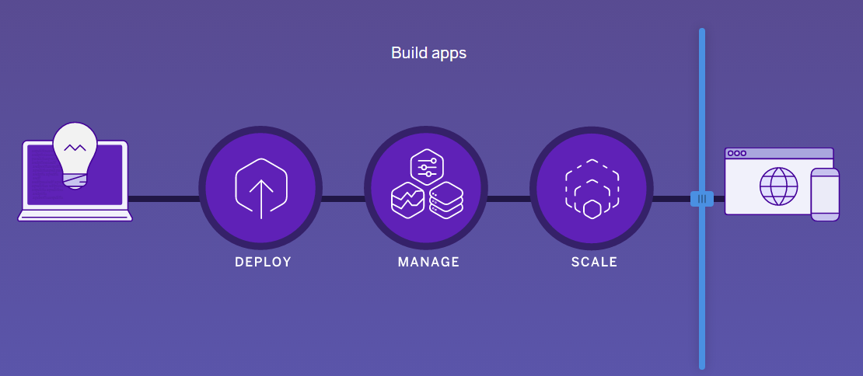
Heroku: “Build apps…

Slide 38
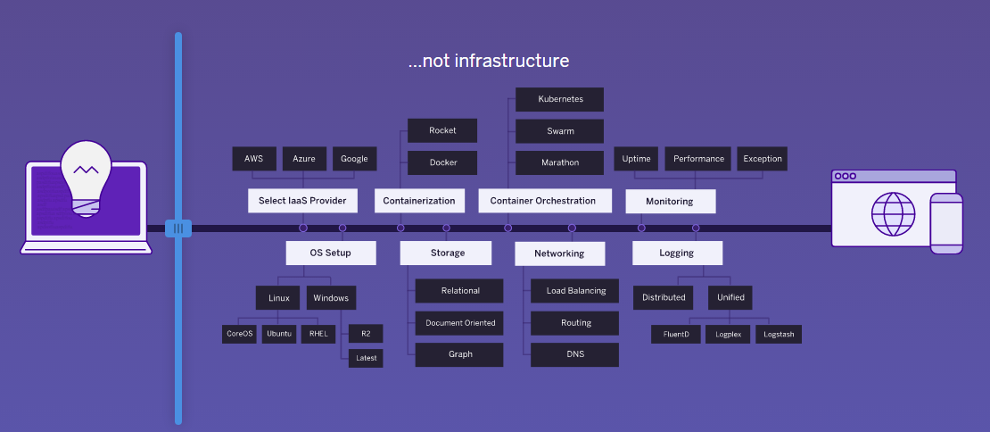
Heroku: “… not infrastructure”

Slide 39
Platform as a service
“Many large organizations see the Cloud and Platform as a Service (PaaS) as an obvious way to standardize infrastructure, ease deployment and operations, and make developers more productive. But it’s still early days…”
(C)ThoughtWorks Radar

Slide 40
Chapter III: Scalability and cost basics

Slide 41
Classic Client-Server Architecture
Client
Request
Server
Response

Slide 42
What about scaling?
10 users -> 10000+ users

Slide 43
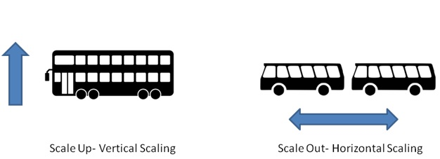
Vertical scaling

Slide 44
Vertical scaling
Server
Client
Request
Response

Slide 45
That’s enough for 90 percent of projects

Slide 46
Horizontal scaling
Server
Load balancer
Server
Client
Request
Response
Server

Slide 47
Traffic story

Slide 48
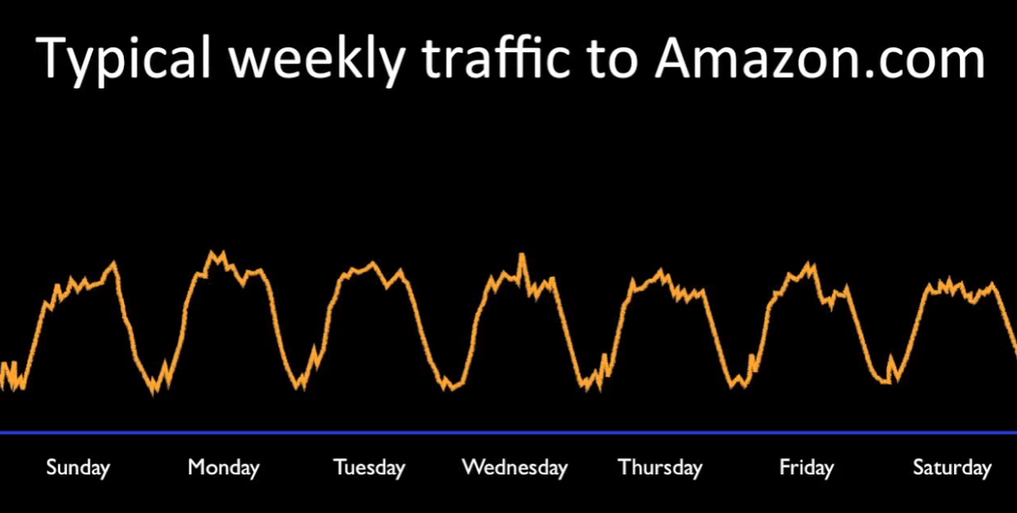
https://www.youtube.com/watch?v=DERzYnthq1s

Slide 49
Black Friday

Slide 50
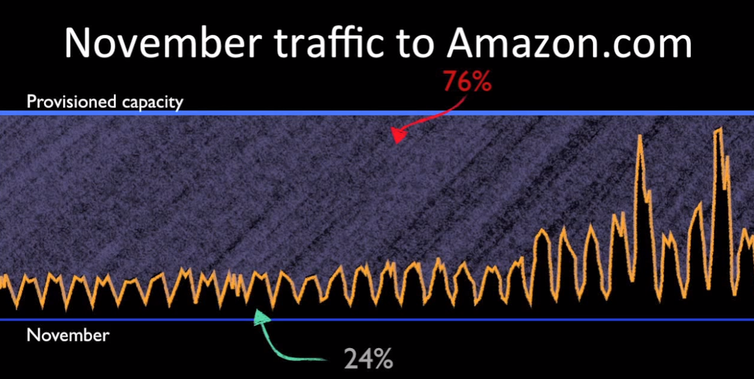
https://www.youtube.com/watch?v=DERzYnthq1s

Slide 51
Chapter IV: Function as a service

Slide 52
Serverless architecture
Infinite scaling
Only pay for the compute that you need
No servers to manage

Slide 53
Function as a service
YOU
Applications
Data
VENDOR MANAGE
Runtime
Middeware
O/S
Virtualization
Servers
Storage
Networking

Slide 54
Function as a Service
Magic
“ephemeral computer power that comes into existence on request and dissapears immediatly after use”
(c) ThoughtWorks Radar

Slide 55
Function as a Service
API Gateway
Client

Slide 56

Amazon API Gateway
Fully managed and scalable RESTful API gateway service
Powered by our content delivery network via 59 global edge locations
https://www.youtube.com/watch?v=YEWtQsqIYsk

Slide 57
Function as a Service
API Gateway
Function
Client
Request
Response

Slide 58
Function as a Service
Function
API Gateway
Function
Client
Request
Response
Function

Slide 59
Function as a Service
Function
API Gateway
Client
Request
Response
Function

Slide 60
30s later…
Function
Function
Function
Function
API Gateway
Function
Request
Function
Client
Function
Function
Response
Function
Function
Function
Function
Function

Slide 61
60s later…
API Gateway
Client

Slide 62
Nanoservices
Functions
API Gateway
POST /users
GET /users
GET /users/:id
PUT /users/:id
DELETE /users/:id
create-user.js
Client
Request
users.js
get-user.js
Response
update-user.js
delete-user.js

Slide 63
Granular Deploy, Update, Scale, Reliability, etc.
Functions
API Gateway
POST /users
GET /users
GET /users/:id
PUT /users/:id
DELETE /users/:id
create-user.js
Client
Request
users.js
get-user.js
Response
update-user.js
delete-user.js

Slide 64
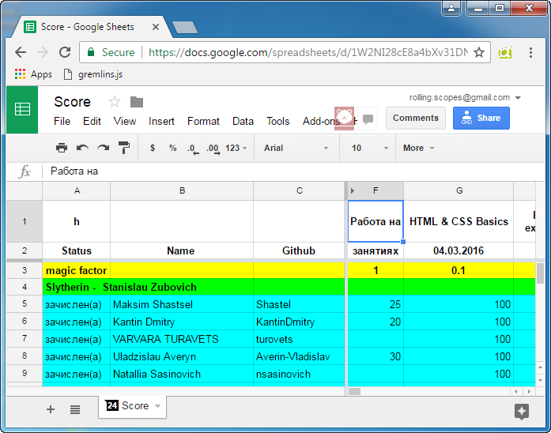
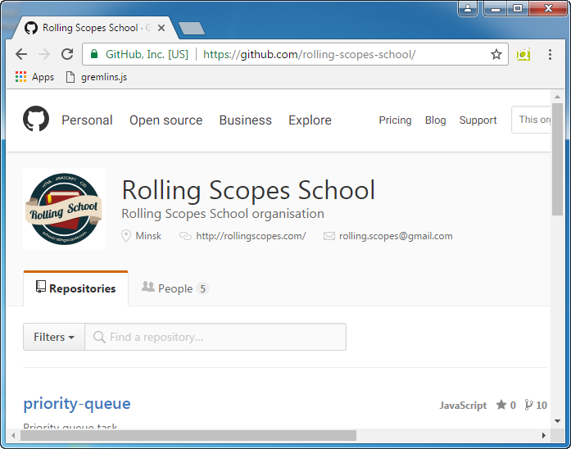
Use case #1

Slide 65
Google Spreadsheets Data API
GitHub WebHooks
API Gateway
Functions
Request
set-mark.js
Response

Slide 66
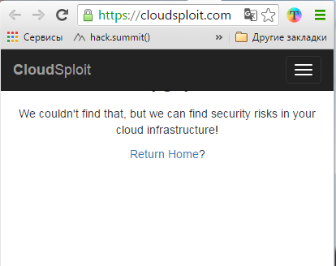
Use case #2 Story: We Made the Whole Company “Serverless”
https://blog.cloudsploit.com/we-made-the-whole-company-serverless-5a91c27cd8c4#.asm49udxm

Slide 67


Client React/Angular
Cloud
AWS S3
API Gateway
users.js
search.js
etc.js

Slide 68
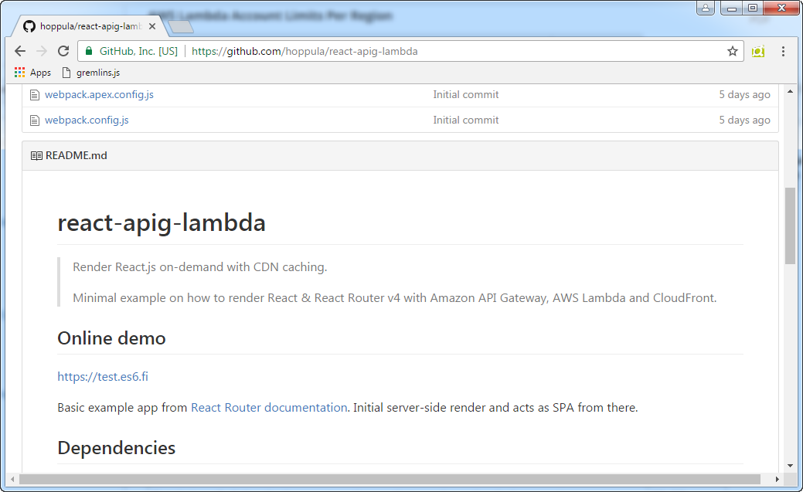

Slide 69
Function as a Service
Functions are the unit of deployment and scaling
No machines, VMs or containers visible in the programming model
Scales per request, Users cannot over- or under-provision capacity

Slide 70
Service Providers
Amazon Lambda
IBM OpenWhisk
Google Cloud Functions
Microsoft Azure Functions
….

Slide 71
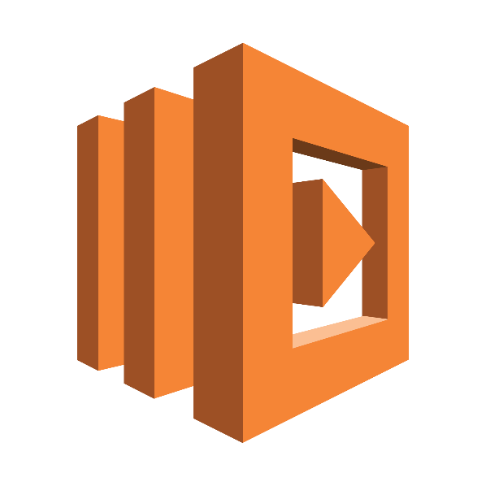
AWS Lambda

Slide 72
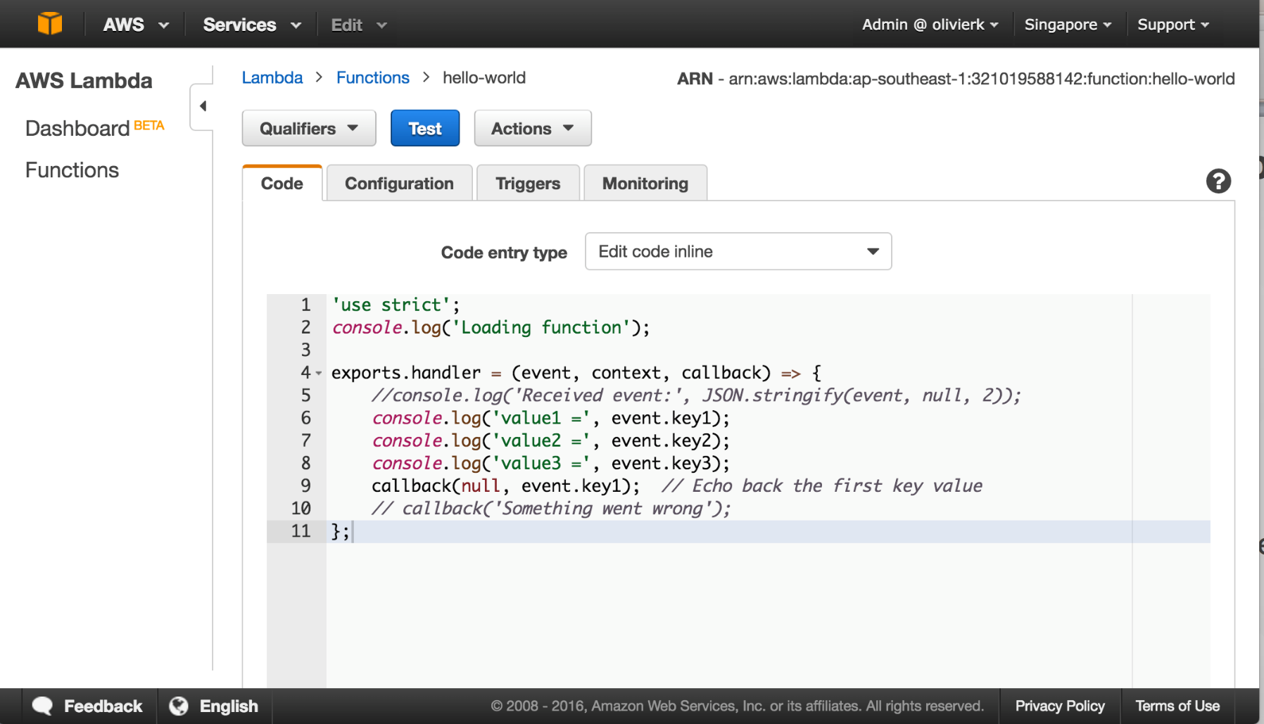
Supports JavaScript, Java Python

Slide 73
Lambda container
API Gateway
Client
Request
Container
Function
Response

Slide 74
Start-up latency
Node 10-100 ms
Java ??? ms
Cold start / Hot start / Container reuse
If start time is crucial, create a scheduled function to keep the Lambda function “warm” (с) AWS

Slide 75
What is Lambda container?
Resource | Default Limit
Ephemeral disk capacity | 512 MB
Invoke request body payload size (RequestResponse) | 6 MB
Invoke response body payload size (RequestResponse) | 6 MB
http://docs.aws.amazon.com/lambda/latest/dg/limits.html

Slide 76
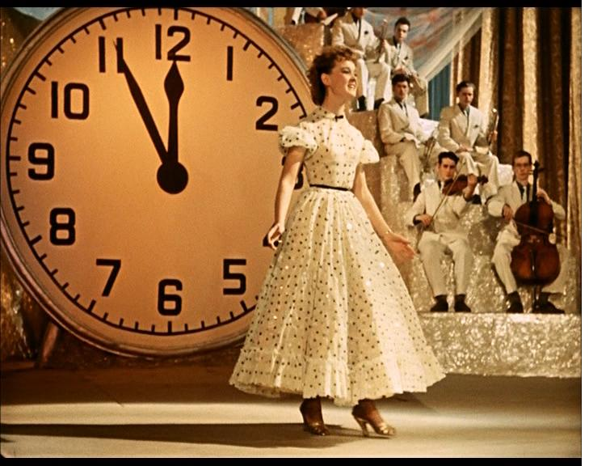
Maximum execution duration per request: 5 min

Slide 77
AWS Lambda Deployment Limits
MAX 50Mb (zip) per Function

Slide 78
Default concurrent executions limits Per Region Per Account
100

Slide 79
NoOps?
Serverless != DevOpsLess
AWS CloudFormation

Slide 80
Phoenix Environments
Using automation, we can create whole environments - including network configuration, load balancing and firewall ports - for example by using CloudFormation in AWS. We can then prove that the process works by tearing the environments down and recreating them from scratch on a regular basis.
(с) ThoughtWorks Radar

Slide 81


Fine-Grained Pricing
Compute time in 100ms increments
Low request charge
No hourly, daily or monthly minimums
No per-device fees
Never pay for idle!
Free Tier
1M requests and 400,000 GBs of compute.
Every month, every customer.

Slide 82
Gigabytes per second (GBps)
Price =
function's RAM size X execution time (sec)
Example: 1GB RAM X 5 min = 0.005001$

Slide 83
ROLLINGSCOPES.COM ☺
Billing: $11.43/month
Instance utilization: 4%/month ☹

Slide 84
Fond of performance optimization?
Direct relationship between cost and performance ☺

Slide 85
Serverless architecture
Serverless was first used to describe applications that significantly or fully depend on 3rd party applications / services (‘in the cloud’) to manage server-side logic and state.
http://martinfowler.com/articles/serverless.html

Slide 86




Usual scenario (for web)
Amazon API Gateway
AWS Lambda
Amazon DynamoDB

Slide 87
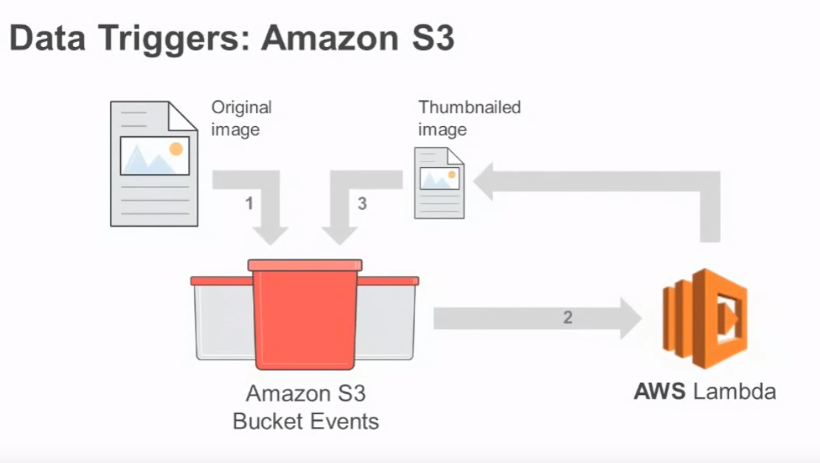
Event-driven Compute in the Cloud

Slide 88
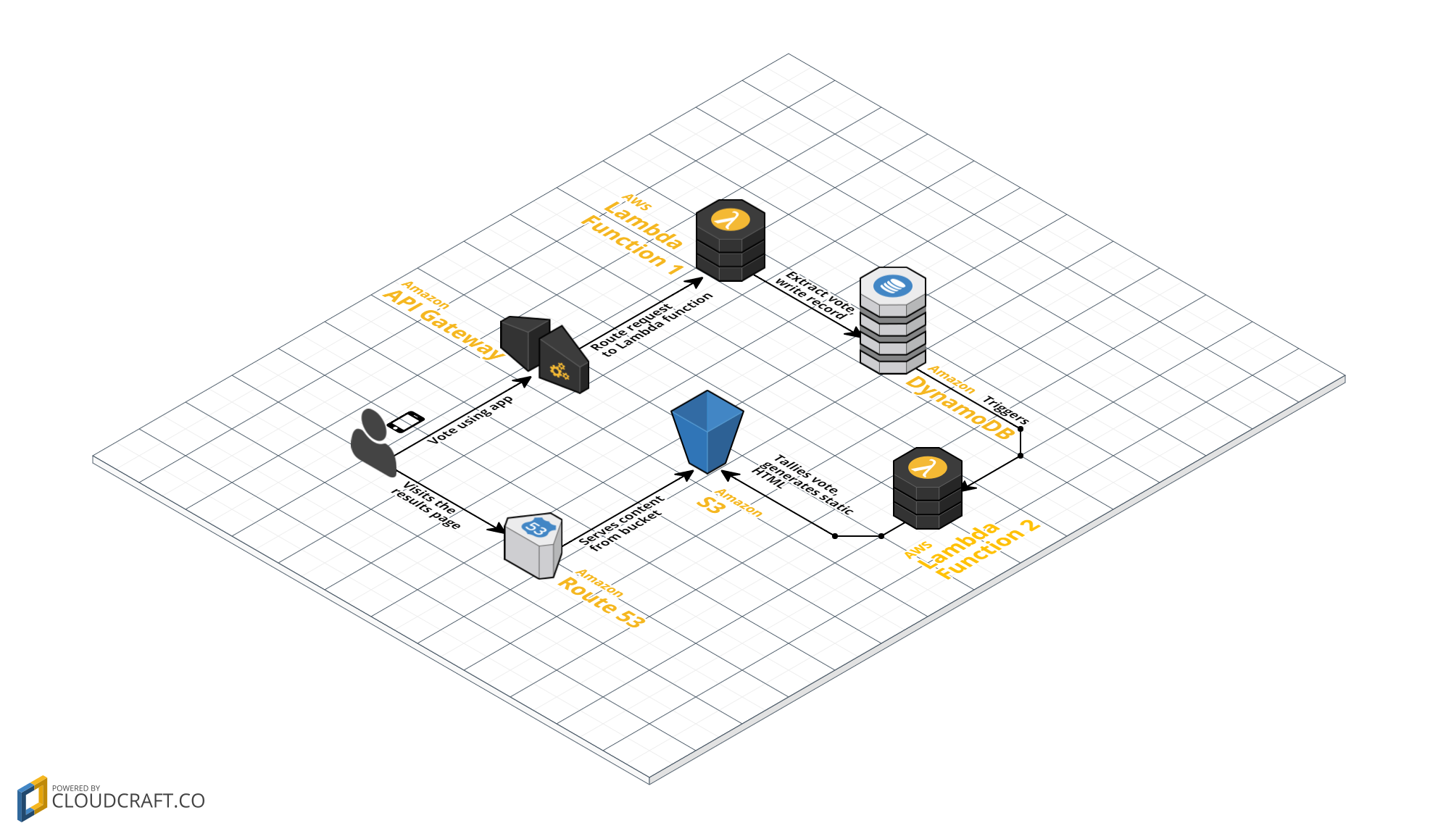

Slide 89
SNS Events
funct1.js
create-user.js
func2.js
func3.js
Topic name

Slide 90
Serverless Reference Architectures with AWS Lambda
Web Applications Serverless Reference Architecture
Mobile Backend Serverless Reference Architecture
Real-time File Processing Serverless Reference Architecture
IoT Backend Serverless Reference Architecture
Real-time Stream Processing Serverless Reference Architecture
http://www.allthingsdistributed.com/2016/06/aws-lambda-serverless-reference-architectures.html

Slide 91
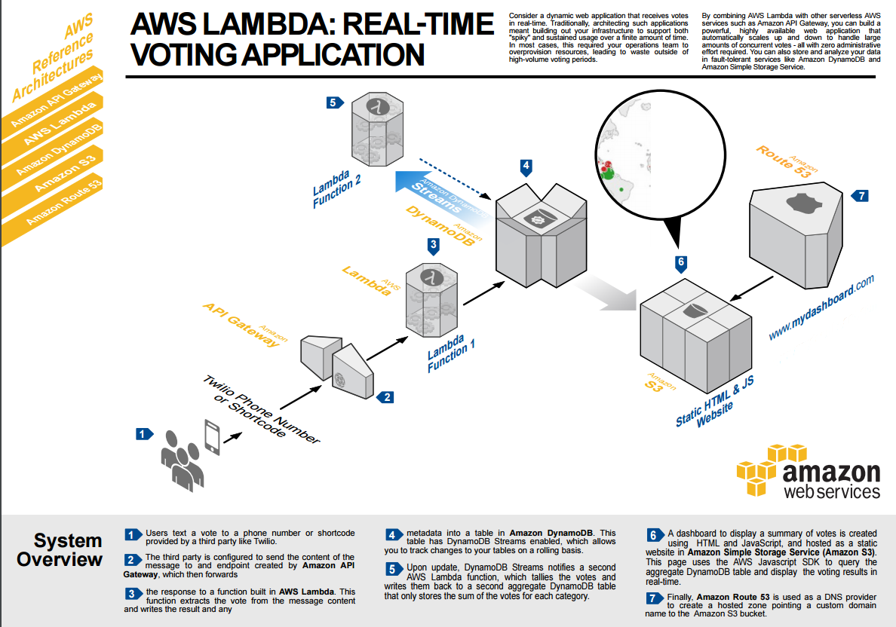
https://github.com/awslabs/lambda-refarch-webapp

Slide 92
Drawbacks

Slide 93
Massive Vendor Lock-In

Slide 94
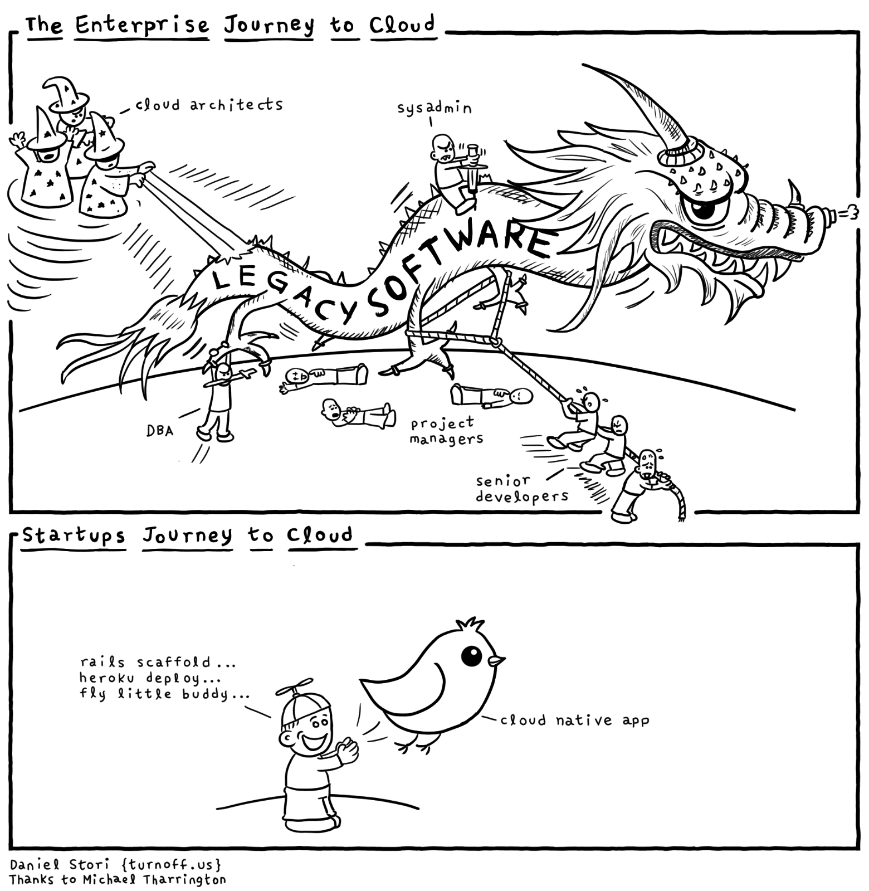

Slide 95
How to debug?
“It is also INCREDIBLY irritating and challenging to debug in a practically infinite number of insanity-inducing ways”
“You cannot ssh into your Lambda.”
“You cannot inspect your program as it’s running. Forget debugging techniques that we’ve accumulated over the years, they don’t apply in this post-Kansas serverless world. Forget dtrace, forget perf, forget flamegraphs. Your debugging arsenal is limited to good old printf debugging. No, scratch that, I should’ve said “good old CloudWatch” debugging, which is a few notches below printf-debugging, because it lags. Hooray!”

Slide 96
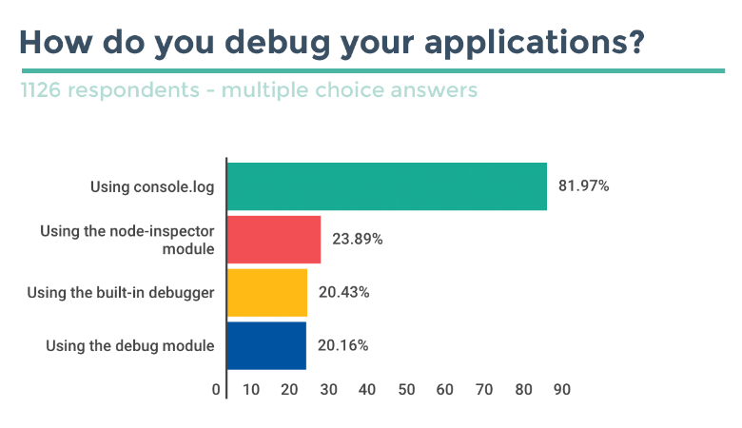
https://blog.risingstack.com/node-js-developer-survey-results-2016/

Slide 97
Serverless === Stateless
No in-proc caching or state

Slide 98
Limited Environments
No local env
One account for QA, UAT, PROD
Integration testing difficulties
Self DDOS ☺

Slide 99
Thank you!

Slide 100
Useful links
AWS Free Tier
https://aws.amazon.com/ru/free/
AWS Lambda Developer Guide
http://docs.aws.amazon.com/lambda/latest/dg/lambda-dg.pdf
Serverless Architectures
http://martinfowler.com/articles/serverless.html

Slide 101
Useful links
What is AWS?
https://www.youtube.com/watch?v=DERzYnthq1s
Your First Week on Amazon Web Services
https://www.youtube.com/watch?v=7CiHBcqw6zc
https://github.com/JustServerless/awesome-serverless
https://github.com/donnemartin/awesome-aws
https://acloud.guru/course/serverlessconf-nyc-2016/dashboard

Slide 102
Useful links
AWS May 2016 Webinar Series - Deep Dive on Serverless Web Applications
https://www.youtube.com/watch?v=fXZzVzptkeo
AWS April Webinar Series - AWS Lambda: Event-driven Code for Devices and the Cloud
https://www.youtube.com/watch?v=YEWtQsqIYsk

